Slide 1
Portal Research
Portal Functions

Slide 2
Portal Research
Research Content
Functions
Community/Social Functions
Customer Support Functions
Marketing Functions
Payment Functions

Slide 3
Research Content
Turkish Game Publisher Company 터키 게임 퍼블리셔
Joygame
Other Publishers (Which has Turkish Language Support) 다른 퍼블리셔(터키어를 제공하는)
MaynGames
GameForge
JoyMax
Foreign Publishers (Only English Language) 해외 퍼블리서(영어만 제공하는)
Nexon-EU
gPotato

Slide 4
Portal Research
Functions
Community/Social Functions

Slide 5
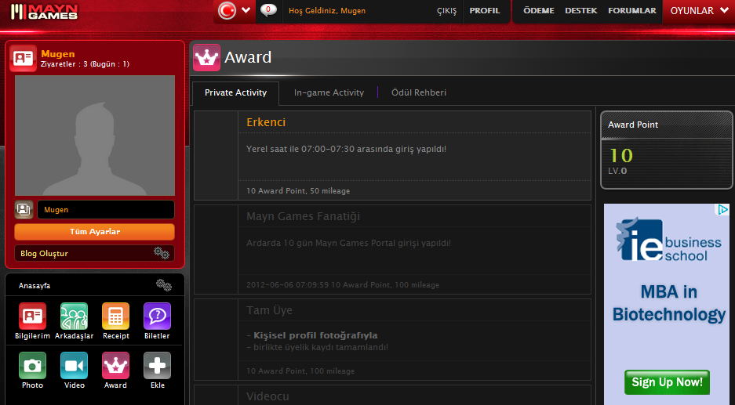
User Blog/Achievements 유저 블로그/ 업적들
Function: User Blog Creation & Portal and In-Game Achievements 유저블로그 생성, 포털과 게임안에서의 업적들이 표시 가능
Type: Comunity/Social 커뮤니티/소셜
Publisher: MaynGames (Link)
Priority : 2nd 우선순위는 2위
5

Slide 6
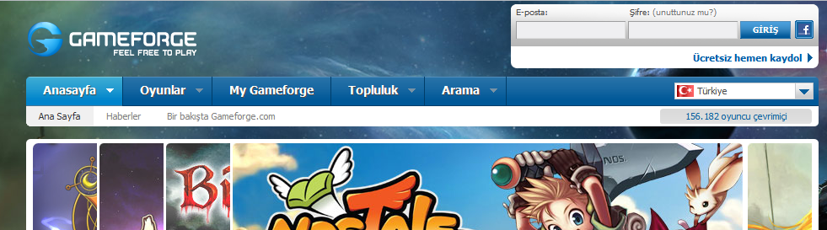
CCU Bar
Function: CCU Datas on Portal Main Page 유저 접속 데이터를 메인페이지에 표시
Type: Social/Community
Publisher: Gameforge (Link)
Priority : 3rd 우선순위 3
6

Slide 7
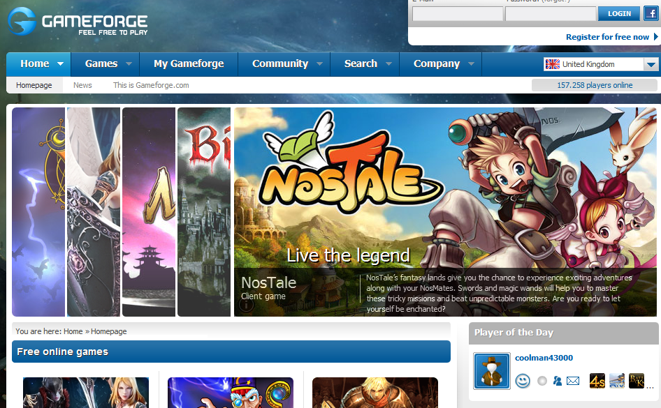
Player of the Day
Function: Player of the Day on Portal Main Page 오늘의 플레이어
Type: Social/Community
Publisher: Gameforge (Link)
Priority : 2nd 우선순위 2
7

Slide 8
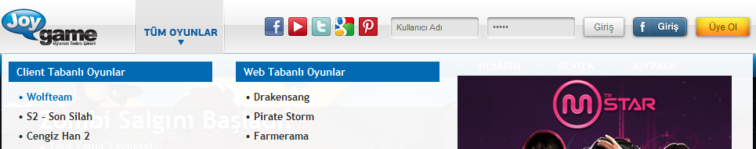
Facebook Login/User Top Bar
Function: Facebook Login/User Top Bar 페이스북 로그인 상단으로 이동
Type: Social/Community
Publisher: Joygame (Link)
Priority : 1st 우선순위 1
1

Slide 9
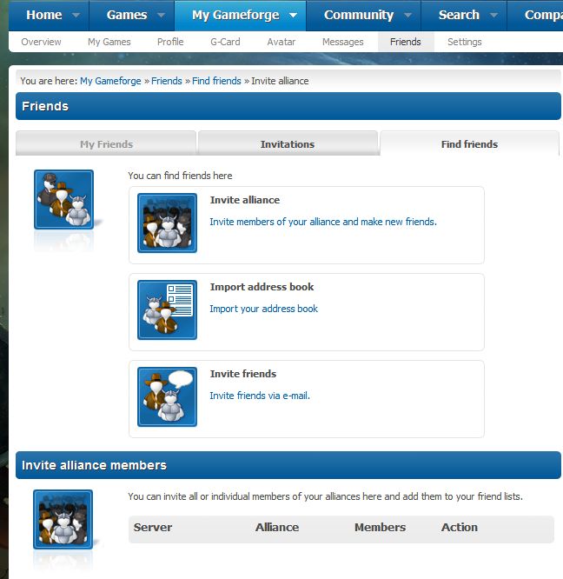
Clan & Alliance Members 클렌 & 동맹 멤버
Function: Player of the Day on Portal Main Page 오늘의 추천 친구 플레이어
Type: Social/Community
Publisher: Gameforge (Link)
Priority : 2nd 우선순위 2
8

Slide 10
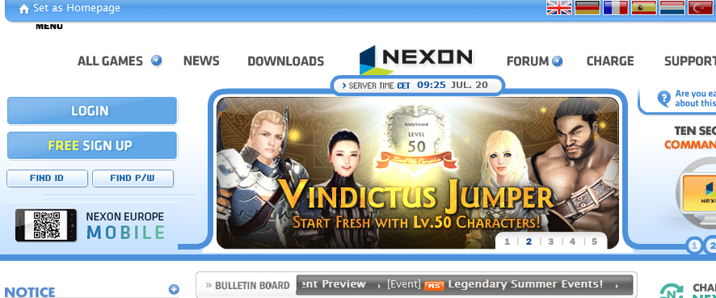
Server Time & Bulletin Board
Function: Server Time, Bulletin Board and Set as Home Page function on Portal Main Page 서버타임, 한줄 알림
Type: Community
Publisher: Nexon-EU (Link)
Priority : 1st 우선순위 1
9

Slide 11
Set as HomePage
Function: Set as Home Page function on Portal Main Page 즐겨찾기 추가
Type: Community
Publisher: Nexon-EU (Link)
Priority : 1st 우선순위 1
10

Slide 12
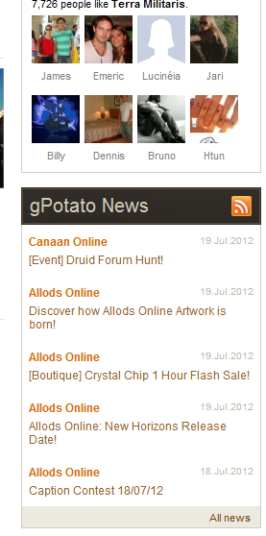
RSS
Function: RSS Support of Portal 포털 뉴스를 RSS로 날려주기
Type: Community
Publisher: gPotato (Link)
Priority : 2nd 우선순위2
13

Slide 13
Portal Research
Functions
Customer Support Functions

Slide 14
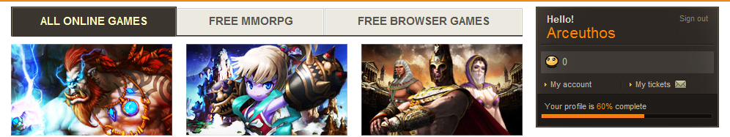
My Tickets Section
Function: My Tickets Section on User Profile 유저에 따른 1:1문의 리스트 링크
Type: Customer Support
Publisher: gPotato (Link)
Priority : Never 절대적으로 해야함
11

Slide 15
Portal Research
Functions
Marketing Functions

Slide 16
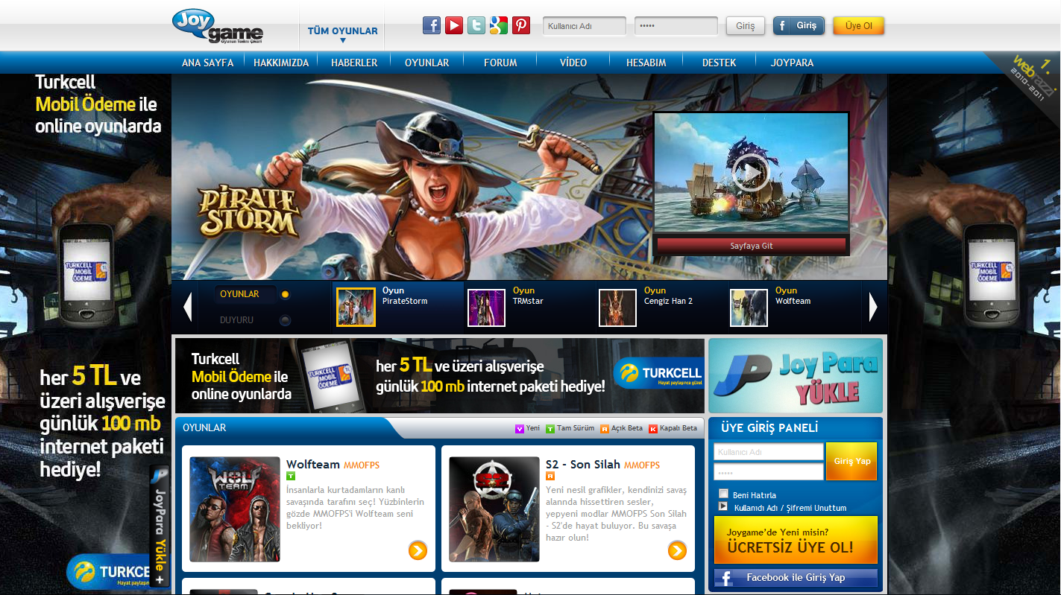
Advertisement Banners
Function: Advertisement Banners on both side 양사이드에 광고배너
Type: Marketing
Publisher: Joygame (Link)
Priority : 2nd 우선순위2
2
2

Slide 17
Portal Research
Functions
Payment Functions

Slide 18
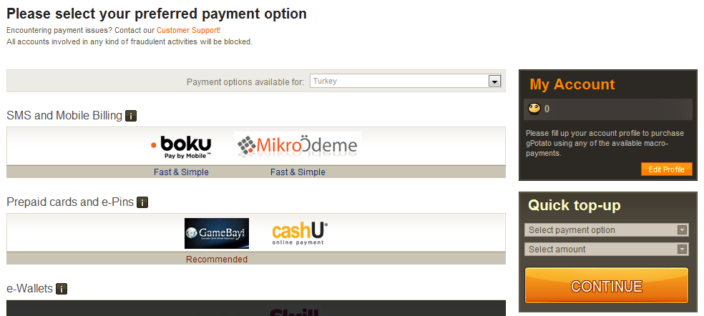
Quick Charge
Function: Quick Game Cash Charge Menu 퀵 게임개쉬 충전 메뉴
Type: Payment
Publisher: gPotato (Link)
Priority : 1st 우선순위1
12

Slide 19
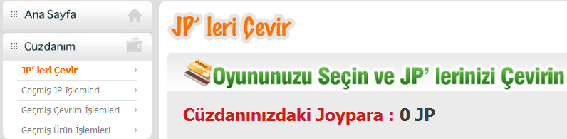
Account Game Cash State
Function: State of Game Cash amount in Portal Account 포털 잔여게임캐쉬 상태 (현재도 충전식으로 되어있는지?)
Type: Payment
Publisher: Joygame
Priority : 1st 우선순위 1
3

Slide 20
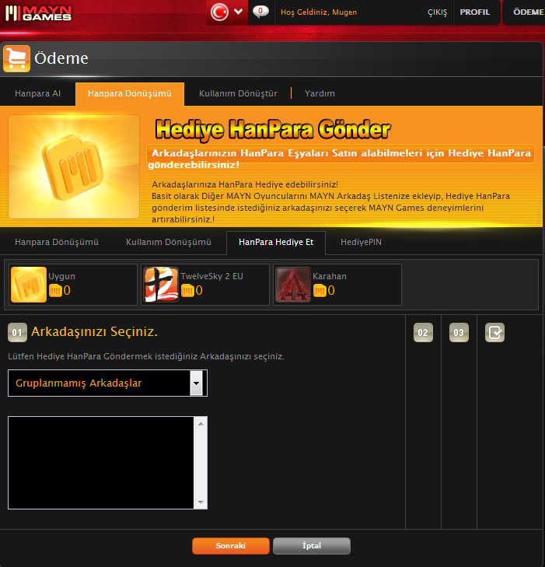
Gifting Game Cash
Function: Gifting Game Cash to other Users 캐쉬 선물하기
Type: Payment/Community
Publisher: MaynGames (Link)
Priority : 1st 우선 순위 1
4

